Slide 1
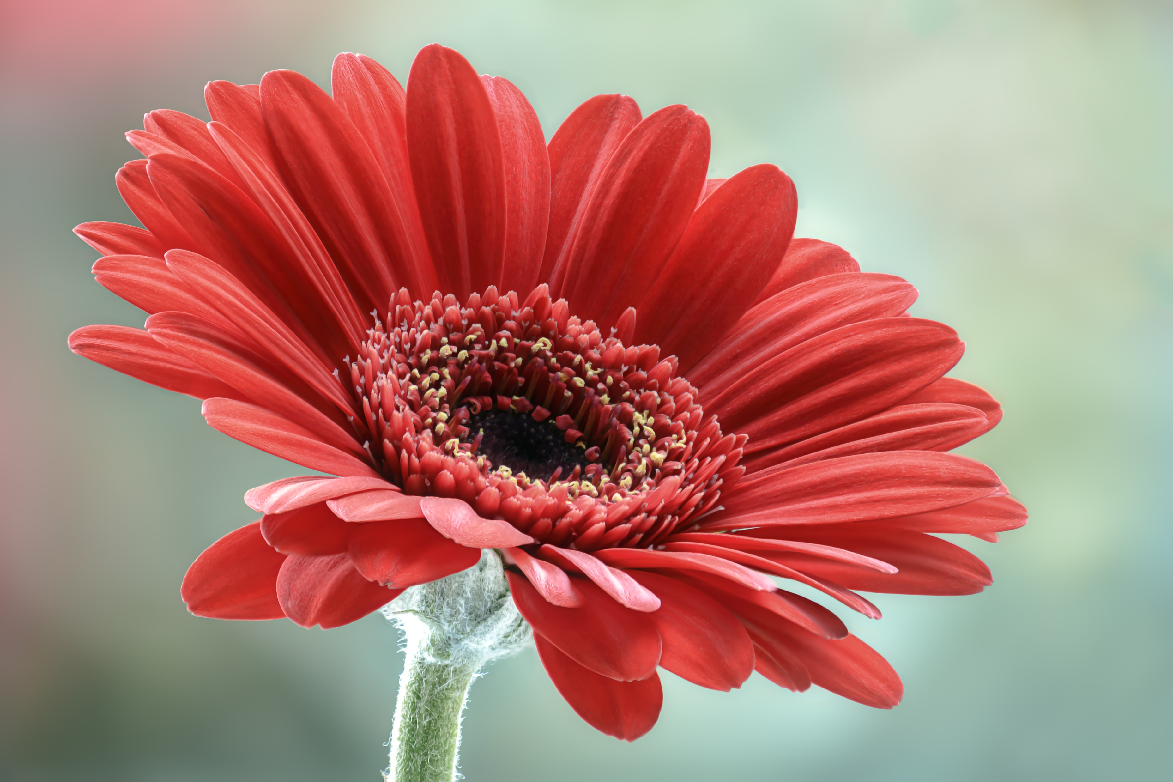

About Daisy
Scientific name: Bellis perennis
Family: Asteraceae
Order: ???
Genus: Bellis
Kingdom: Plantae
Sometimes qualified or known as
common daisy
lawn daisy
English daisy.

Slide 2

About Rose
A rose is either a woody perennial flowering plant of the genus Rosa, in the family Rosaceae, or the flower it bears. There are over three hundred species and tens of thousands of cultivars.
Scientific name: Rosa
Family: Rosaceae
Subfamily: Rosoideae
Genus: Rosa; L.
Kingdom: Plantae

